Slide 1

ENVIRONEMT SCIENCE, WASTE AND DISASTER MANAGEMENT
Dr. Akriti
Assistant Professor
Department Of Civil Engineering
Chandigarh University
Gharuan, Mohali, Punjab
ENVIRONMENTAL POLLUTION AND THEIR EFFECTS
DISCOVER . LEARN . EMPOWER

Slide 2
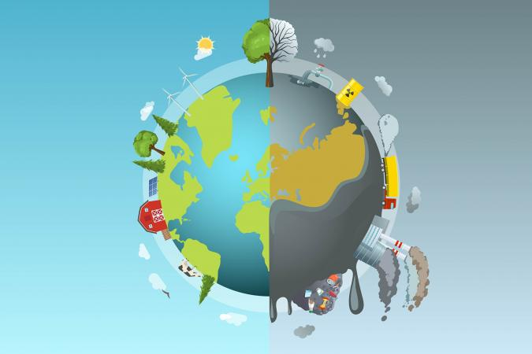
ENVIRONMENTAL POLLUTION AND THEIR EFFECTS
Course Outcome
CO Number | Title
CO1 | Understand different dimensions of environmental studies; problems related to environmental degradation & the remedial steps taken to address them.
CO2 | Understand the different types of disasters that occur in nature consequently learning to develop preparedness and remedial techniques.
CO3 | Understand the diverse problems associated with solid waste, as well as waste segregation and effective management techniques.
CO4 | Critically analyzing the roles and identities as citizens, consumers, and environmental actors in a complex, interconnected world.
CO5 | Create awareness about environmental issues and carry out outreach activities.

Slide 3

SUSTAINABLE DEVELOPMENT GOALS
TYPES OF NATURAL RESOURCES

Slide 4

SUSTAINABLE DEVELOPMENT GOALS
The 2030 Agenda for Sustainable Development, adopted by all United Nations Member States in 2015, provides a shared blueprint for peace and prosperity for people and the planet, now and into the future. At its heart are the 17 Sustainable Development Goals (SDGs), which are an urgent call for action by all countries - developed and developing - in a global partnership. They recognize that ending poverty and other deprivations must go hand-in-hand with strategies that improve health and education, reduce inequality, and spur economic growth – all while tackling climate change and working to preserve our oceans and forests.
TYPES OF NATURAL RESOURCES

Slide 5
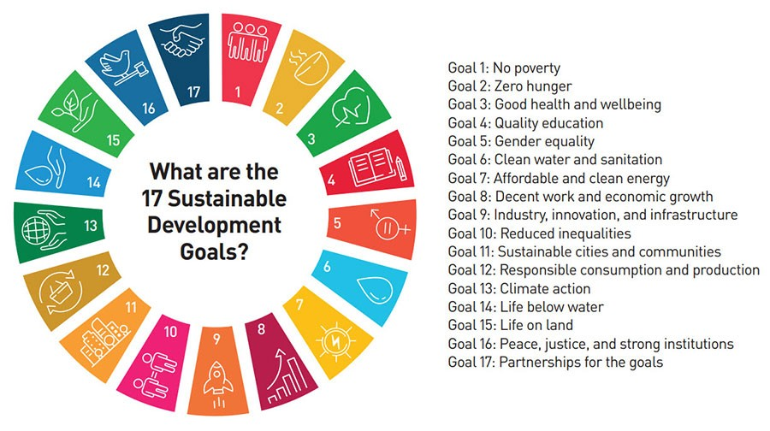
SUSTAINABLE DEVELOPMENT GOALS
The Division for Sustainable Development Goals (DSDG) in the United Nations Department of Economic and Social Affairs (UNDESA) provides substantive support and capacity-building for the SDGs and their related thematic issues, including water, energy, climate, oceans, urbanization, transport, science and technology, the Global Sustainable Development Report (GSDR), partnerships and Small Island Developing States. DSDG plays a key role in the evaluation of UN systemwide implementation of the 2030 Agenda and on advocacy and outreach activities relating to the SDGs. In order to make the 2030 Agenda a reality, broad ownership of the SDGs must translate into a strong commitment by all stakeholders to implement the global goals. DSDG aims to help facilitate this engagement.
TYPES OF NATURAL RESOURCES

Slide 6

SUSTAINABLE DEVELOPMENT GOALS
TYPES OF NATURAL RESOURCES

Slide 7
SUSTAINABLE DEVELOPMENT GOALS
TYPES OF NATURAL RESOURCES

Slide 8
SUSTAINABLE DEVELOPMENT GOALS
TYPES OF NATURAL RESOURCES

Slide 9
SUSTAINABLE DEVELOPMENT GOALS
TYPES OF NATURAL RESOURCES

Slide 10
SUSTAINABLE DEVELOPMENT GOALS
TYPES OF NATURAL RESOURCES

Slide 11
SUSTAINABLE DEVELOPMENT GOALS
TYPES OF NATURAL RESOURCES

Slide 12
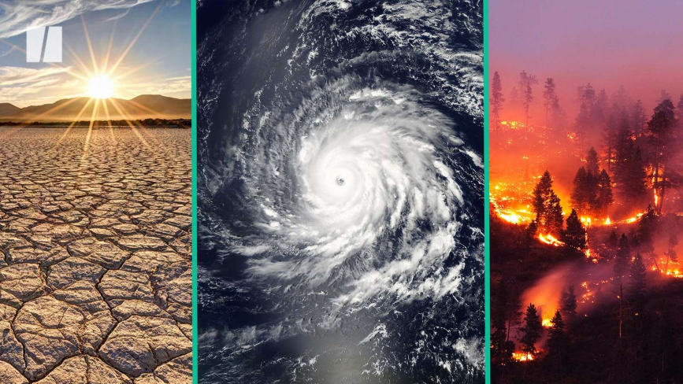
CLIMATE CHANGE
Short-term or long-term alteration of the statistical properties of a climate system. Such a change can be temporary or permanent. It can occur regionally or globally
United Nations Framework Convention on Climate Change defines this as "a change of climate which is attributed directly or indirectly to human activity that alters the composition of the global atmosphere and which is in addition to natural climate variability Observed over comparable time periods."
TYPES OF NATURAL RESOURCES
24-11-2023

Slide 13
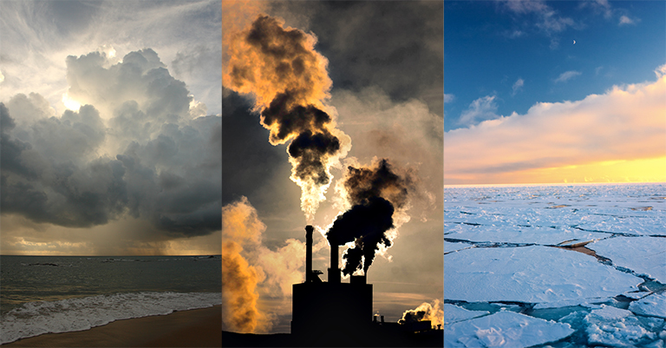
CAUSES OF CLIMATE CHANGE
Burning Fossil Fuels: The combustion of fossil fuels like coal, oil, and natural gas for energy production, transportation, and industrial processes releases large amounts of carbon dioxide (CO2) and other greenhouse gases into the atmosphere. These gases accumulate and create a "blanket" effect, trapping heat and causing the Earth's temperature to rise.
Deforestation: Clearing forests, especially tropical rainforests, reduces the planet's capacity to absorb CO2 through photosynthesis. Deforestation also releases carbon stored in trees and disrupts natural carbon and moisture cycles.
Industrial Processes: Various industries release greenhouse gases, such as methane (CH4) and nitrous oxide (N2O), as byproducts of manufacturing and chemical reactions. For example, cement production releases significant amounts of CO2.
Agriculture: Agricultural activities contribute to climate change through emissions of methane (from livestock digestion and manure management) and nitrous oxide (from fertilizer use and soil management practices).
Waste Management: The decomposition of organic waste in landfills produces methane emissions, a potent greenhouse gas.
24-11-2023

Slide 14
EFFECTS OF CLIMATE CHANGE
Continued Temperature Rise: Without significant efforts to mitigate greenhouse gas emissions, global temperatures will continue to rise, resulting in more frequent and severe heatwaves, altered precipitation patterns, and shifts in ecosystems.
Sea Level Rise: Melting glaciers and ice sheets will contribute to rising sea levels, leading to increased coastal erosion, flooding, and the displacement of coastal communities. Low-lying areas and islands are particularly vulnerable.
Extreme Weather Events: More intense storms can cause widespread damage to infrastructure, agriculture, and communities. Heavy rainfall events may lead to increased flooding and landslides.
Biodiversity Loss: Changes in habitats and climate conditions may lead to species extinctions and shifts in ecosystems. Loss of biodiversity can disrupt ecosystems' ability to provide essential services and resources.
Food and Water Insecurity: Crop failures, altered growing seasons, and changing precipitation patterns could threaten global food production. Water scarcity may impact agriculture, drinking water supplies, and sanitation.
24-11-2023

Slide 15
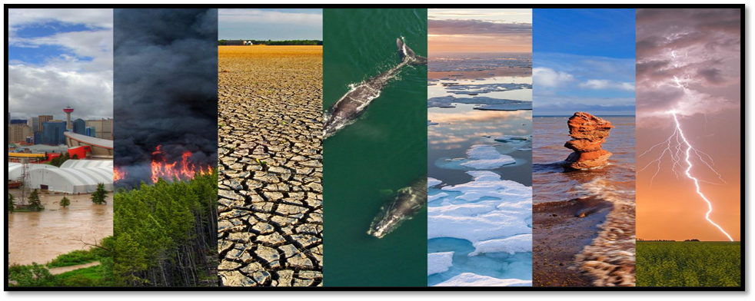
CONTROL OF CLIMATE CHANGE
Use of carbon-emitting fuel consumption should be minimized. Instead substitute energy sources such as solar power, wind force; hydro-electricity should be used.
Transportation causes greenhouse gas emissions, so walk, cycle or take transit whenever you can. If can't go car-free, try carpooling or car sharing, and use the smallest, most fuel-efficient vehicle possible.
Plant maximum number of trees as they release oxygen and absorb CO2 present in the atmosphere and reduce the amount of CO2 present in the air.
Switch off unwanted electric equipment immediately. Or do not use them if not necessary. Replace the old ones with energy-efficient lighting. Go for an energy-saving appliances.
24-11-2023

Slide 16
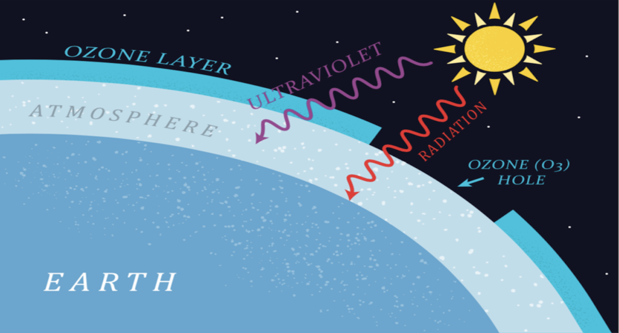
OZONE LAYER DEPLETION
Ozone layer depletion refers to the thinning of the ozone layer in Earth's stratosphere.
The ozone layer plays a crucial role in protecting life on Earth by absorbing the majority of the sun's harmful ultraviolet (UV) radiation.
Ozone depletion is primarily caused by human-made chemicals called ozone-depleting substances (ODS), such as chlorofluorocarbons (CFCs), halons, and other related compounds.
TYPES OF NATURAL RESOURCES

Slide 17
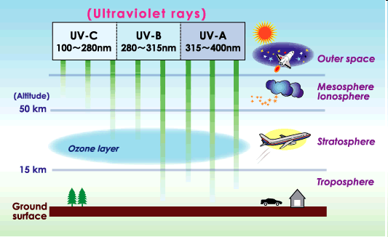
CONSEQUENCES OF OZONE LAYER DEPLETION
On human health:-
Worse sun burn
More eye cataracts
More skin cancers
Immune system suppression
On aquatic life:-
Reduced population of surface phytoplankton's
Disrupted aquatic food webs from reduced phytoplankton's
Reduced sea food supplies
On forest & wildlife:-
Decreased population of species sensitive to UV radiation
Increased diseased animals due to low immune system
Decrease forest productivity for UV-sensitive tree species
TYPES OF NATURAL RESOURCES

Slide 18
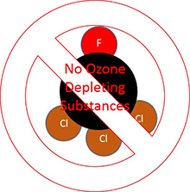
MEASURES TO REDUCE OZONE LAYER DEPLETION
Implement strict regulations and timelines for the phase-out of ODS production and consumption.
Strengthen and enforce the Montreal Protocol, a global treaty aimed at phasing out the production and consumption of ODS.
Promote the development and use of alternative substances with lower or no ozone-depleting potential, such as hydrofluorocarbons (HFCs) and natural refrigerants.
Educate consumers about the importance of choosing products and technologies that are ozone-friendly.
Provide technical assistance and capacity-building to developing countries to help them comply with regulations.
TYPES OF NATURAL RESOURCES

Slide 19

POPULATION GROWTH
Population growth is the increase in the number of individuals in a population. To determine whether there has been population growth, the following formula is used:
(Birth rate + immigration) - (death rate + emigration)
TYPES OF NATURAL RESOURCES

Slide 20
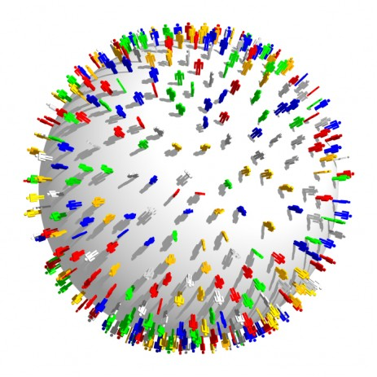
POPULATION GROWTH
CONSEQUENCES OF OVER POPULATION
Depletion of Natural Resources
Degradation of Environment
Rise in Unemployment
Conflicts and Wars
Health Problems
Loss of biodiversity
24-11-2023

Slide 21

PARIS AGREEMENT
The Paris Agreement is an agreement within the United Nations Framework Convention on Climate Change (UNFCCC) dealing with greenhouse gas emissions mitigation, adaptation and finance starting in the year 2020.
In the Paris Agreement, each country determines plans and regularly reports its own contribution it should make in order to mitigate global warming.
Rich countries should help poorer nations by providing “climate finance” to adapt to climate change and switch to renewable energy.

Slide 22

PARIS AGREEMENT
Holding the increase in the global average temperature to well below 2 °C above pre-industrial levels and to pursue efforts to limit the temperature increase to 1.5 °C above pre-industrial levels, recognizing that this would significantly reduce the risks and impacts of climate change;
Increasing the ability to adapt to the adverse impacts of climate change and foster climate resilience and low greenhouse gas emissions development, in a manner that does not threaten food production;

Slide 23

PARIS AGREEMENT
Nationally Determined Contributions (NDCs): Each participating country (known as a Party) submits its own nationally determined contribution outlining its climate action plans, including specific emission reduction targets and strategies. NDCs are reviewed and updated every five years to enhance ambition over time.

